Slide 1

Solution architecture backed deployment models

Slide 2
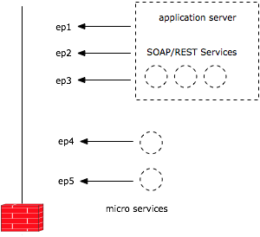
Services
Sits behind the firewall
Deploys in an application server
Deploys in containers as embedded runtimes
Atomic (mostly)
Has a HTTP (mostly) endpoint

Slide 3
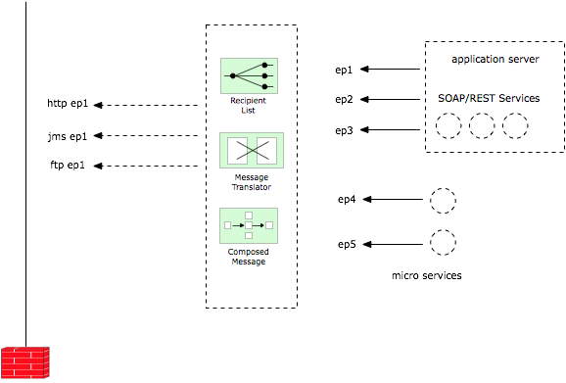
Orchestrations
Sits behind the firewall
Handles by an integration server (aka ESB)
Follows enterprise integration patterns
Handles multiple protocols

Slide 4
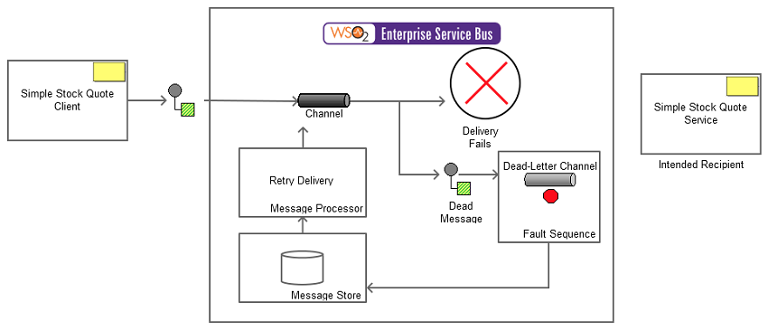
Reliable messaging (queues)
Implements with a message broker (MB)
Used to add reliability for a message flow
Used with an integration tool like ESB
Communicates via a standard protocol like JMS

Slide 5
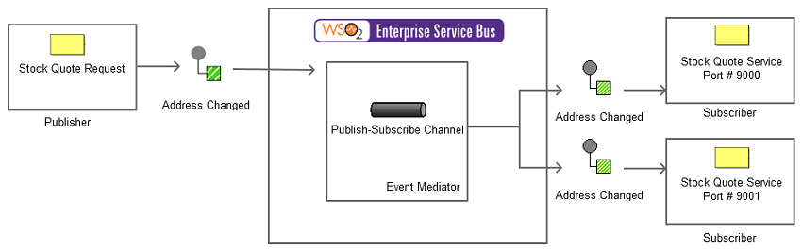
Publish-Subscribe
Used to broadcast a message to multiple recipients
Uses Topics in a message broker
Fire and forget type interactions

Slide 6
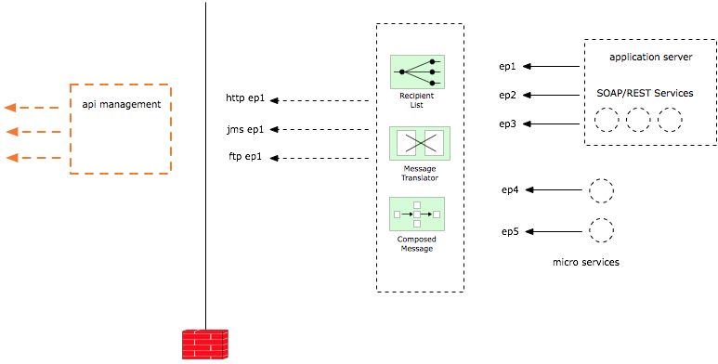
API Management
API Gateway typically sits in the DMZ
Route external traffic to the internal system
Manage life cycles and versions

